Slide 1
How CNN structures influence learning in Flappy Bird
Kelsye Anderson

Slide 2
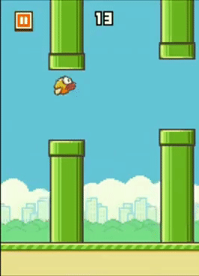
Description
I explored how changing the structure of our Convolutional Neural Network affects the learning rate of our agent when playing the game Flappy Bird by testing the trained models against different difficulty levels

Slide 3
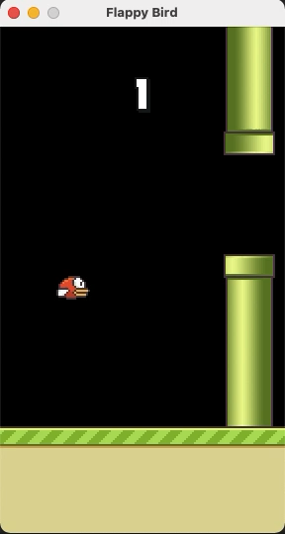
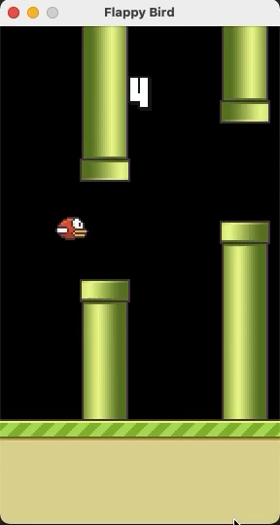
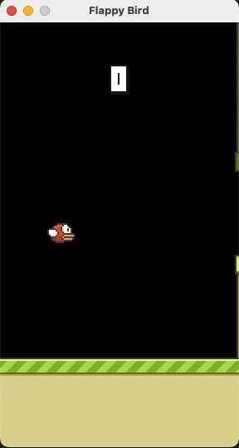
Demos Easy Normal Difficult

Slide 4
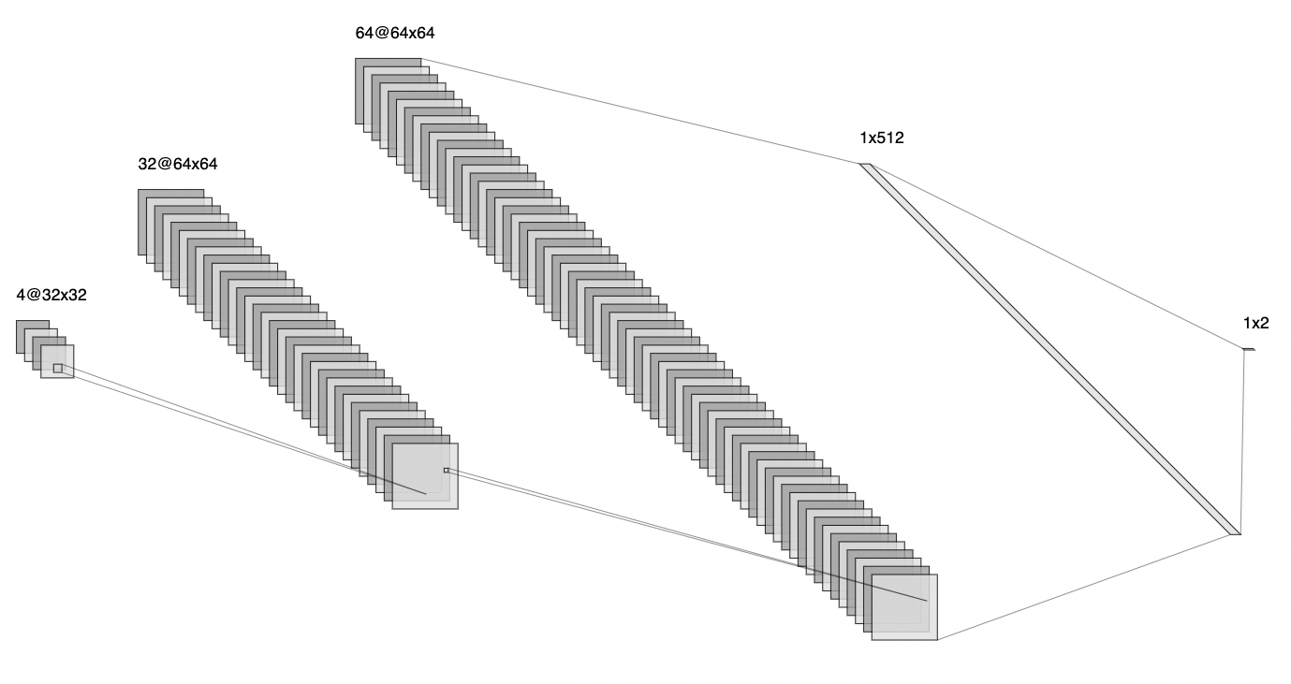
First CNN
1,685,154 parameters

Slide 5
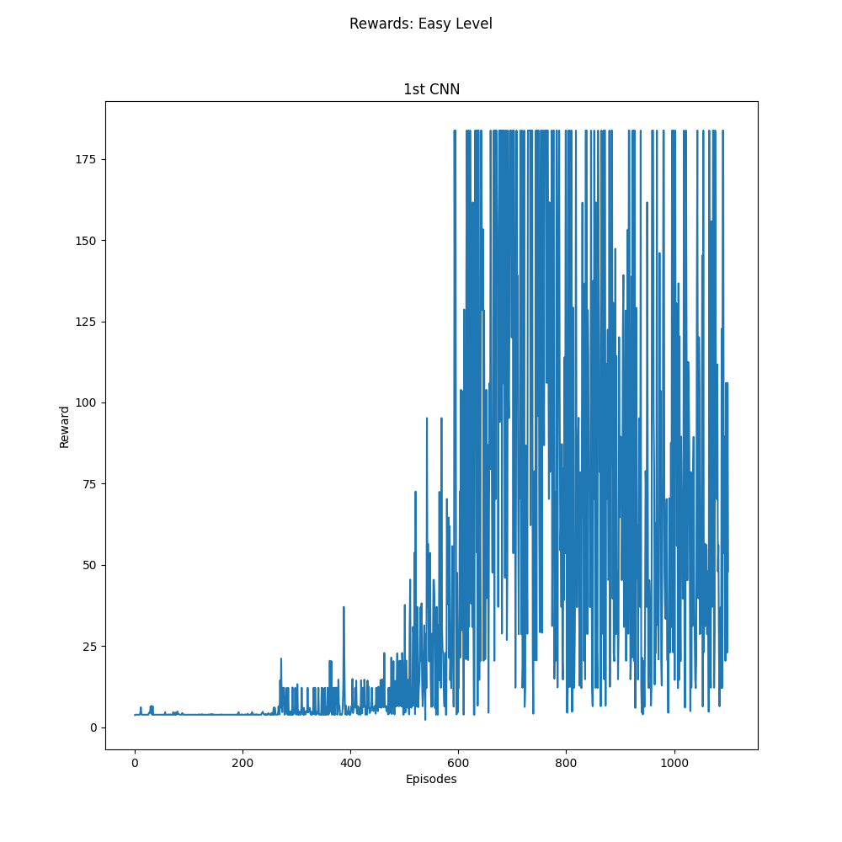
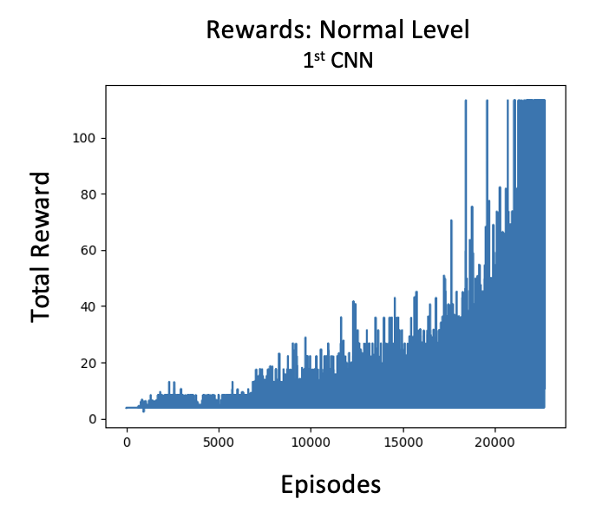
Training Results

Slide 6
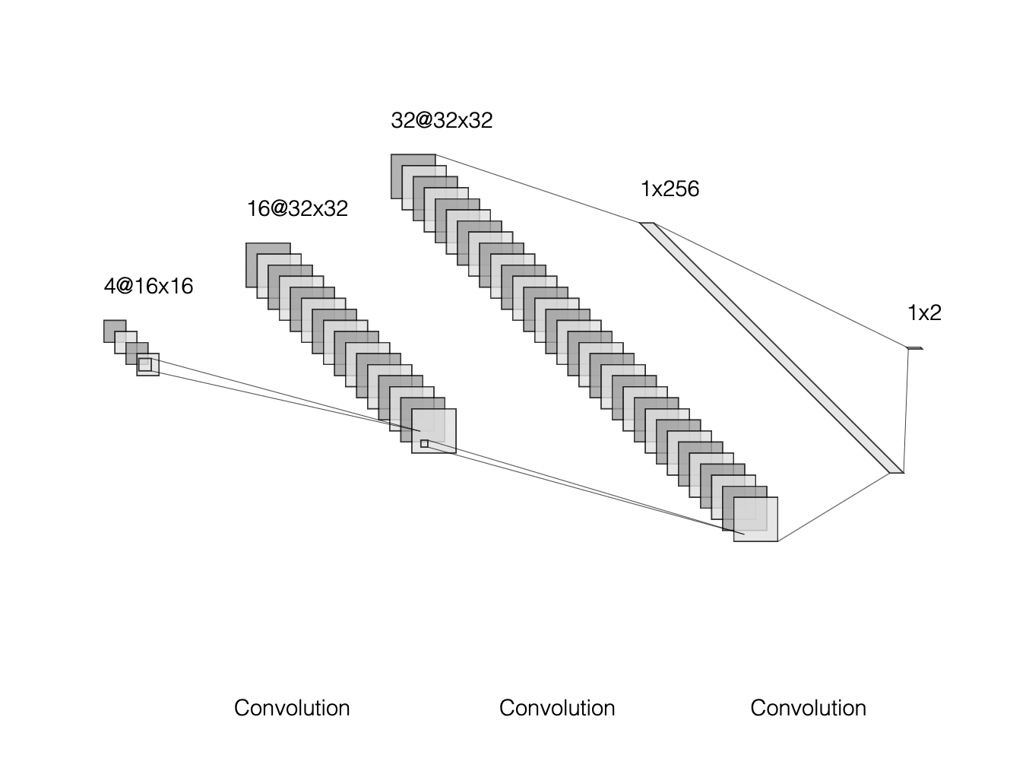
Second CNN
60,738 parameters

Slide 7
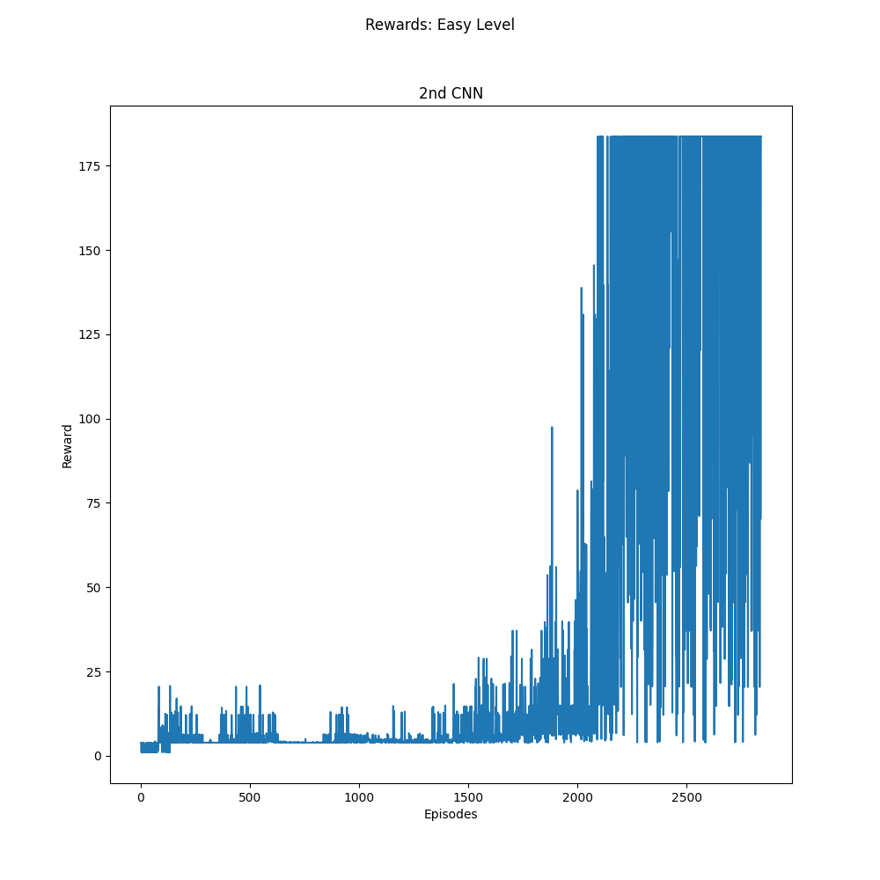
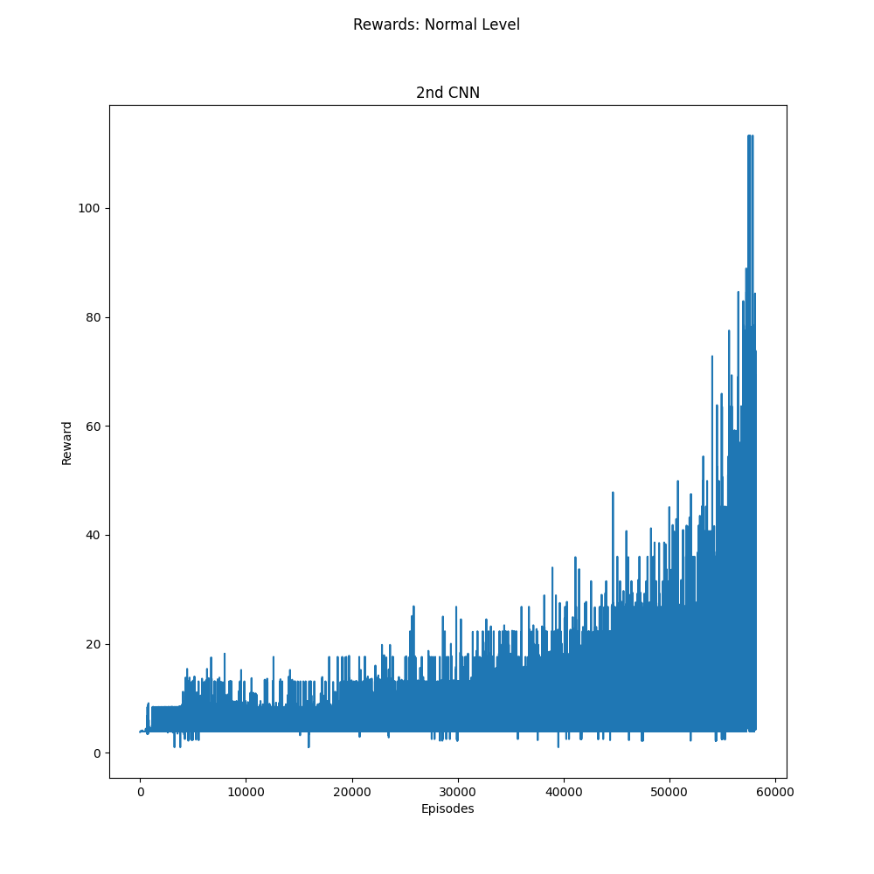
Training Results

Slide 8
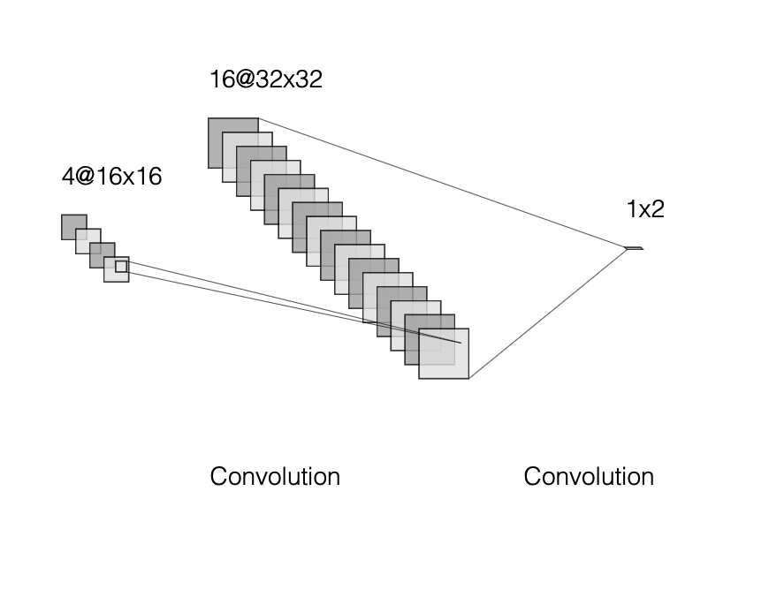
Third CNN
16, 069 parameters

Slide 9
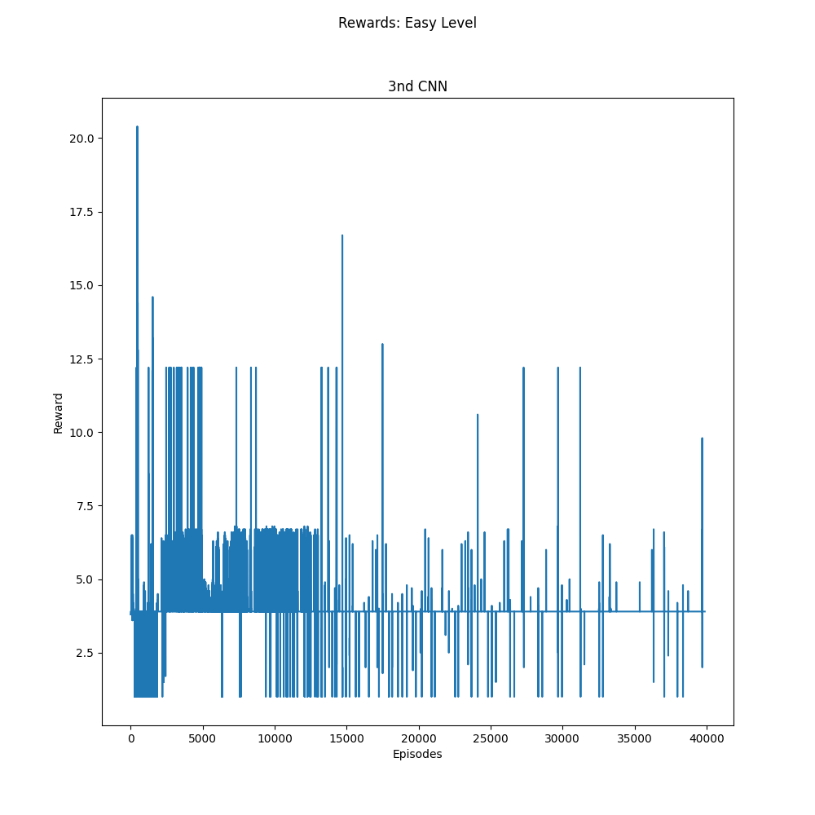
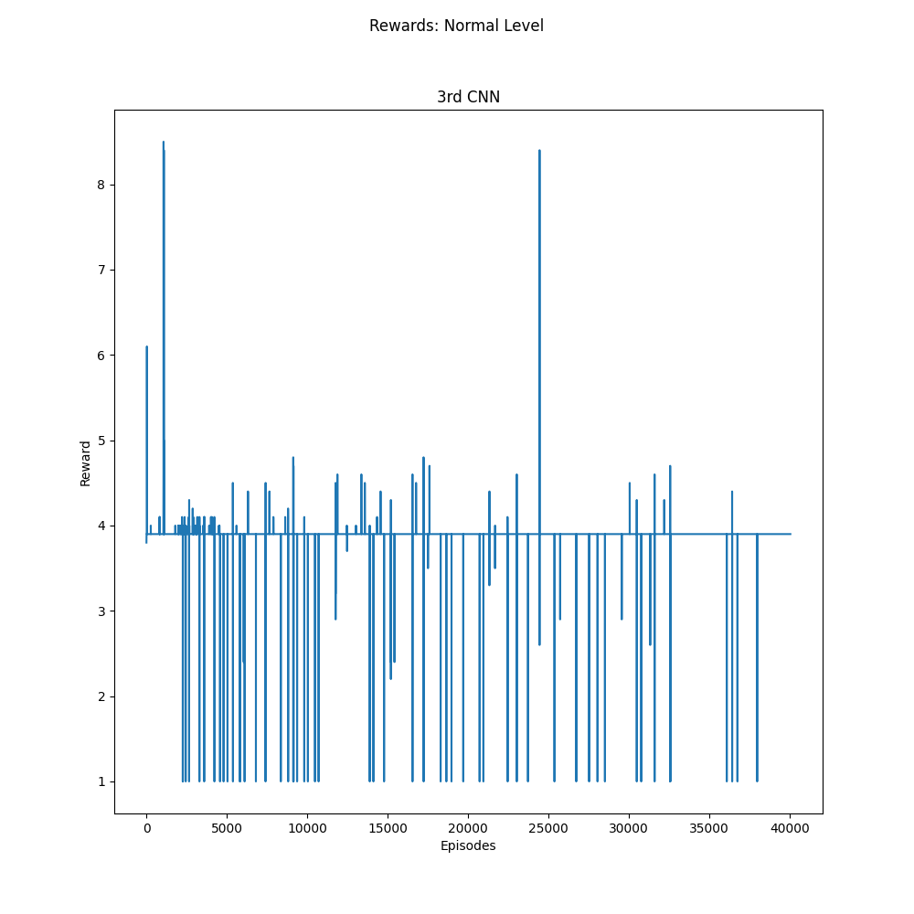
Training Results

Slide 10
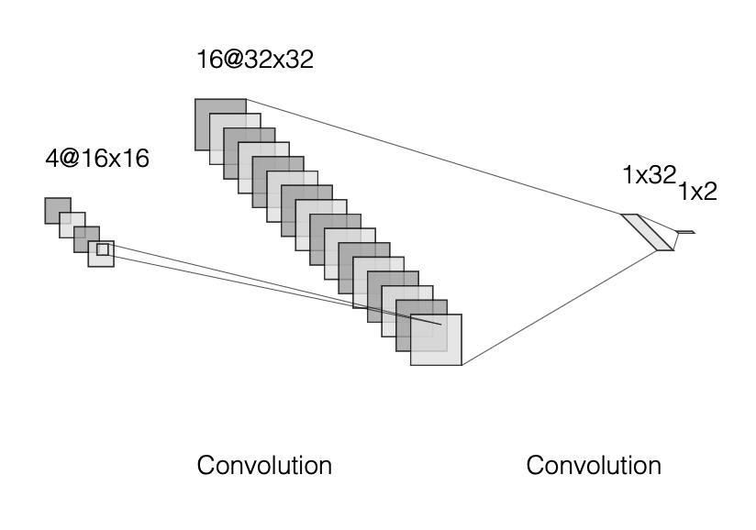
Fourth CNN

Slide 11
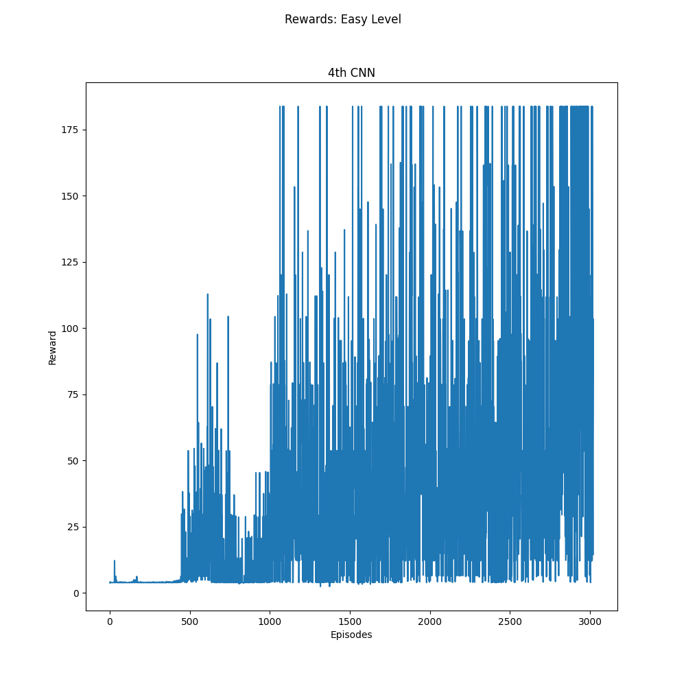
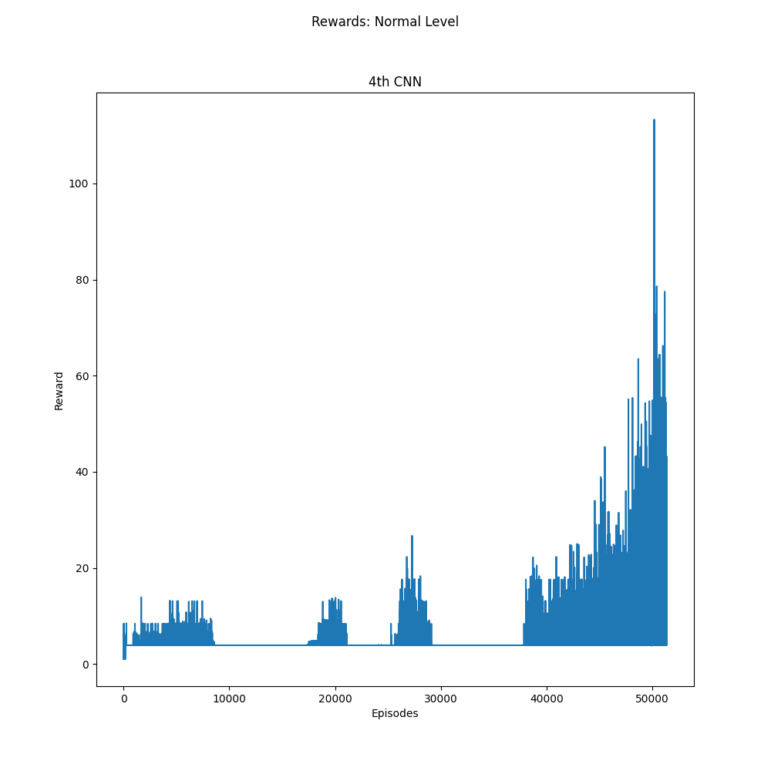
Training Results

Slide 12
Testing Our Models
Now that we've trained all our models, we can begin testing them against more difficult levels to see how well it was able to learn the game
Considering our third CNN was unable to learn its own level, I didn't include it in the results to avoid trivial charts
To test our other models, we can run each of the models against a harder level for 1000 episodes and create histograms of how well they did

Slide 13
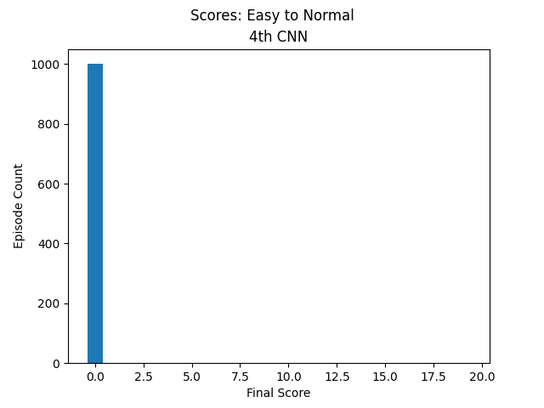
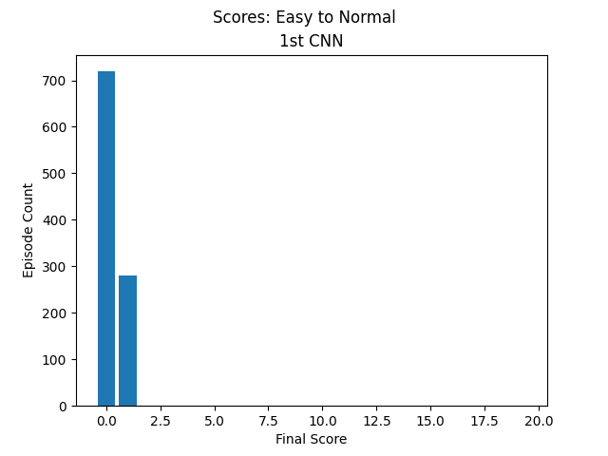

Results
Easy to Normal

Slide 14
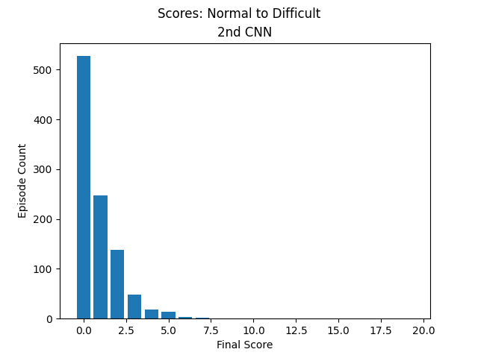
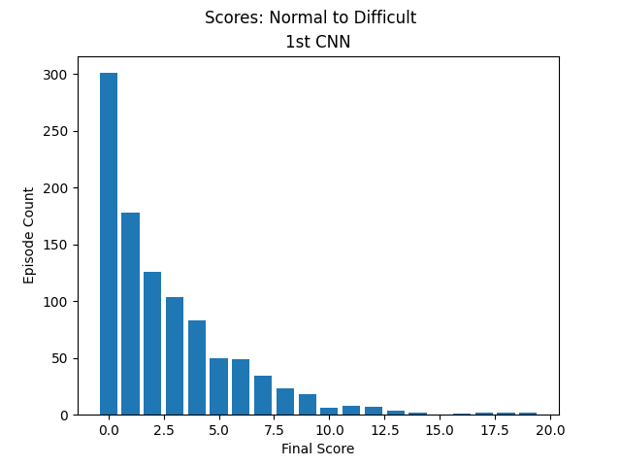
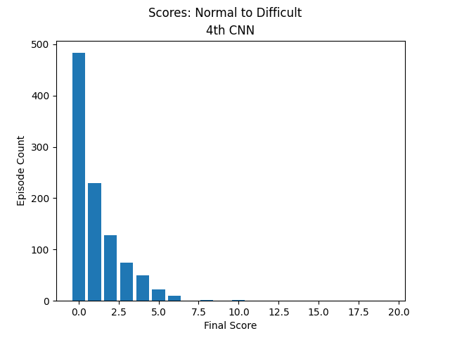
Results
Normal to Difficult

Slide 15
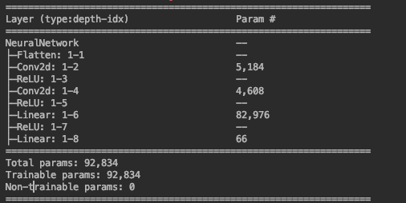
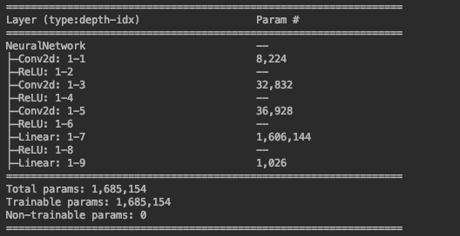
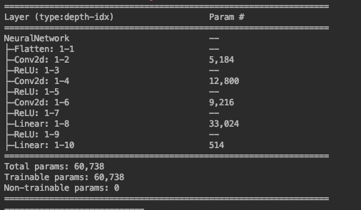
Conclusion
Our agent was able to learn much faster (in CPU time) on a smaller convolutional neural network, however the quality of its learning was compromised.
There is a strong correlation between the number of parameters included our neural network and the quality of model we’re able to train
1st CNN Summary
2nd CNN Summary
4th CNN Summary

Slide 16
Questions?

